Slide 1

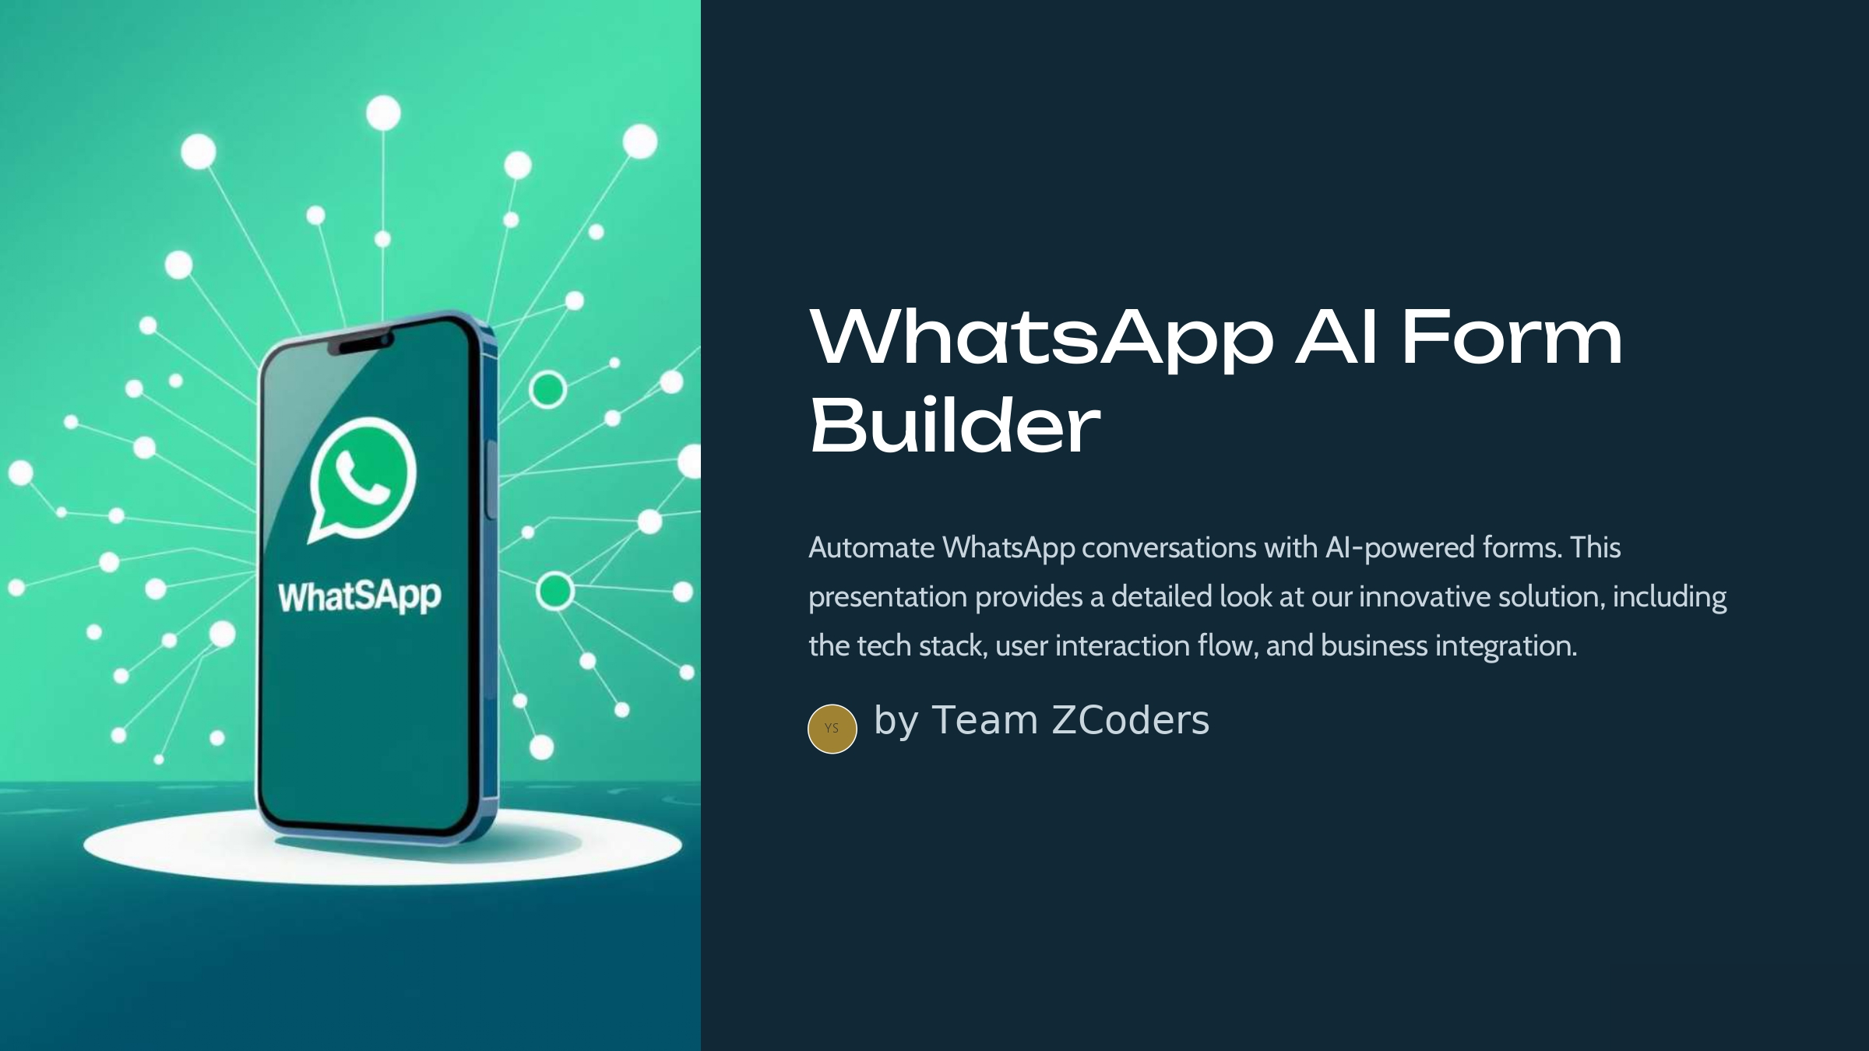
WhatsApp AI Form Builder
Automate WhatsApp conversations with AI-powered forms. This presentation provides a detailed look at our innovative solution, including the tech stack, user interaction flow, and business integration.
YS
by YOGESH SAINI

Slide 2
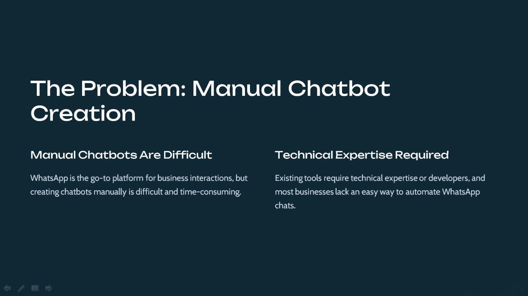
The Problem: Manual Chatbot Creation
Manual Chatbots Are Difficult
Technical Expertise Required
WhatsApp is the go-to platform for business interactions, but creating chatbots manually is difficult and time-consuming.
Existing tools require technical expertise or developers, and most businesses lack an easy way to automate WhatsApp chats.

Slide 3
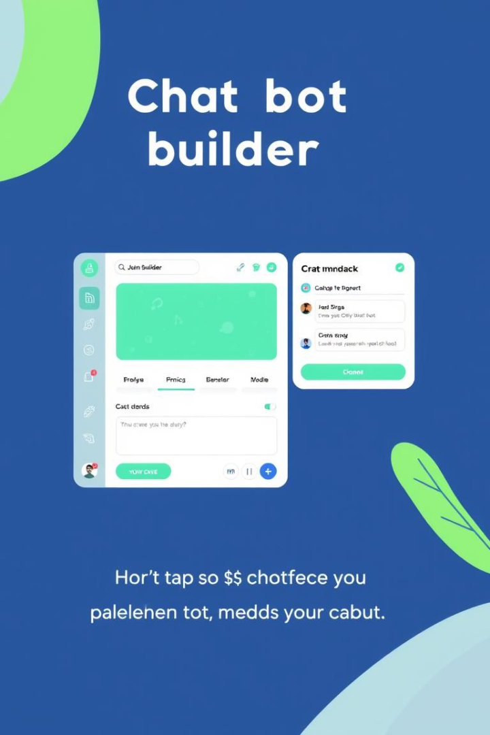



Our Solution: AI-Powered Form Builder
No-Code Platform
Easy Chatbot Creation
A no-code WhatsApp Form Builder powered by AI.
Drag-and-drop interface for easy chatbot creation.
Seamless Automation
WhatsApp API integration for seamless automation.

Slide 4
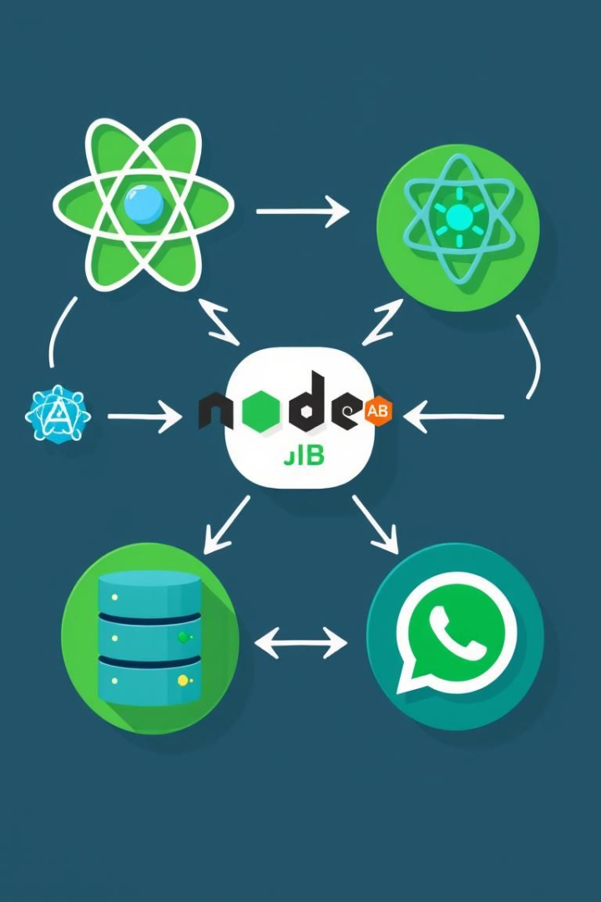



Tech Stack: MERN with AI and WhatsApp API
Frontend
React.js (Drag-and-drop chatbot builder)
Backend
Node.js + Express.js (Handles API requests)
Database
MongoDB (Stores chatbot flows & user interactions)
We are using a MERN (MongoDB, Express.js, React.js, Node.js) Stack with AI and WhatsApp API. We also use Gemini API / OpenAI API (Auto-generates chat flows) and Meta’s Cloud API (For sending & receiving messages) with Webhooks & WebSockets for real-time bot communication.

Slide 5
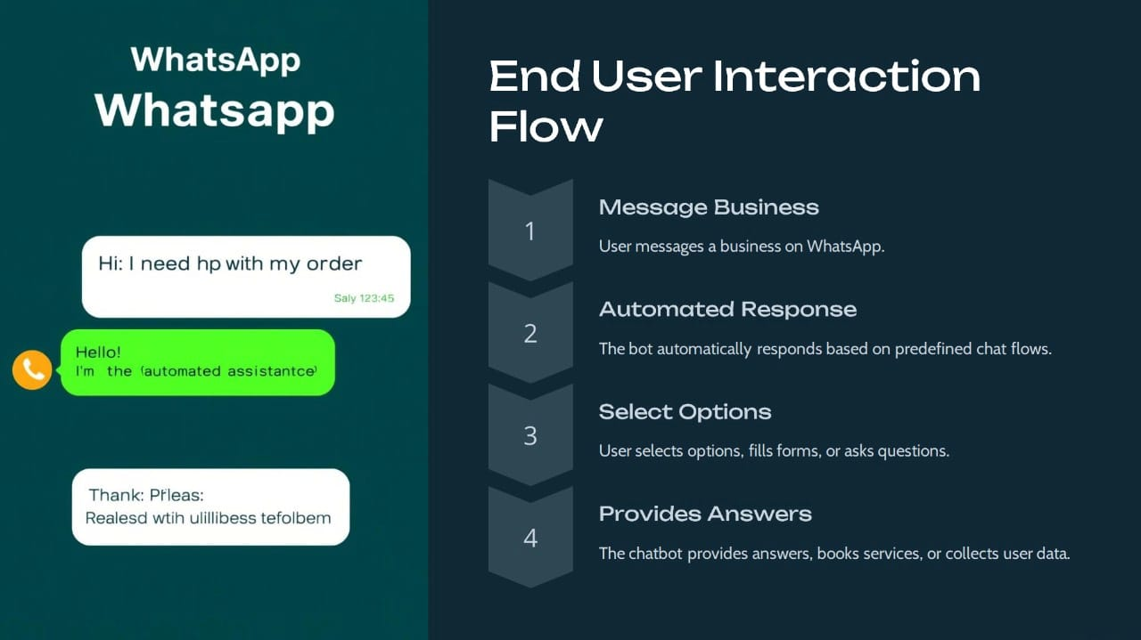
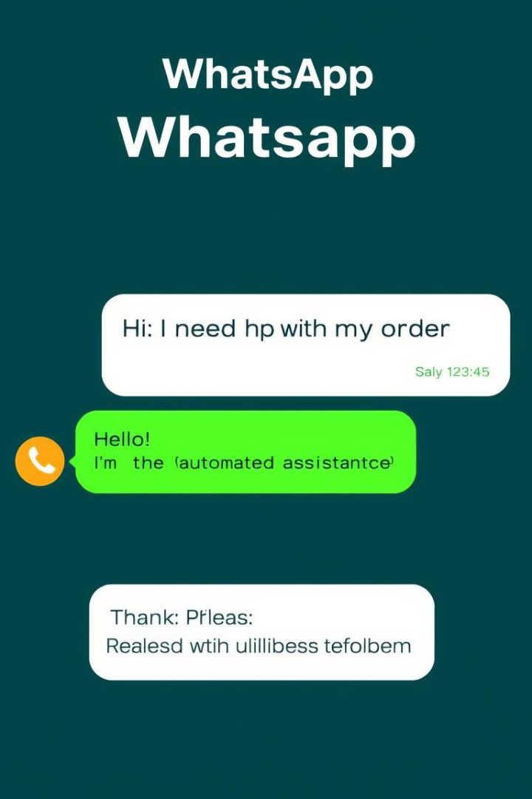




End User Interaction Flow
Message Business
User messages a business on WhatsApp.
Automated Response
The bot automatically responds based on predefined chat flows.
Select Options
User selects options, fills forms, or asks questions.
Provides Answers
The chatbot provides answers, books services, or collects user data.

Slide 6
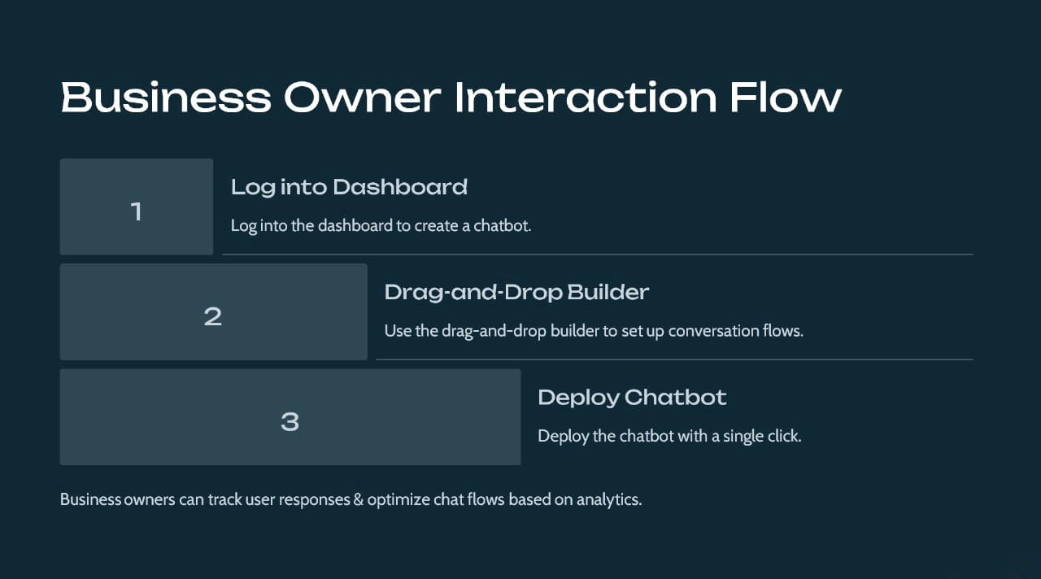
Business Owner Interaction Flow
Log into Dashboard
1
Log into the dashboard to create a chatbot.
Drag-and-Drop Builder
2
Use the drag-and-drop builder to set up conversation flows.
Deploy Chatbot
3
Deploy the chatbot with a single click.
Business owners can track user responses & optimize chat flows based on analytics.

Slide 7
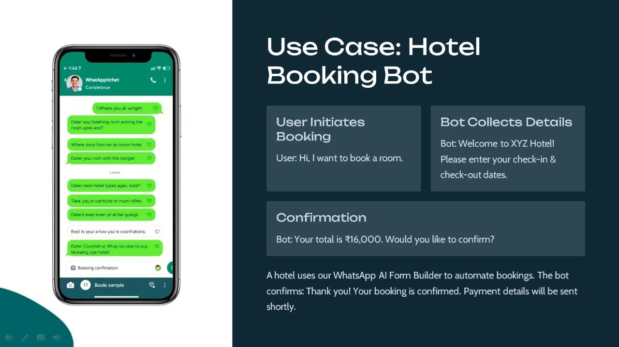
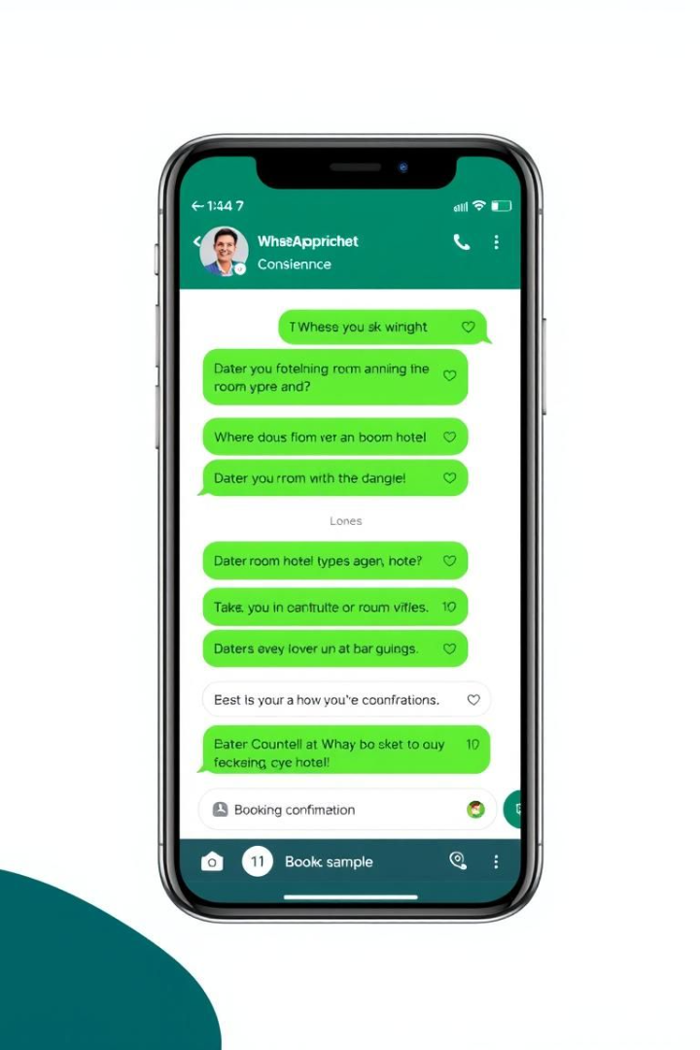
Use Case: Hotel Booking Bot
User Initiates Booking
Bot Collects Details
Bot: Welcome to XYZ Hotel! Please enter your check-in & check-out dates.
User: Hi, I want to book a room.
Confirmation
Bot: Your total is ₹16,000. Would you like to confirm?
A hotel uses our WhatsApp AI Form Builder to automate bookings. The bot confirms: Thank you! Your booking is confirmed. Payment details will be sent shortly.

Slide 8
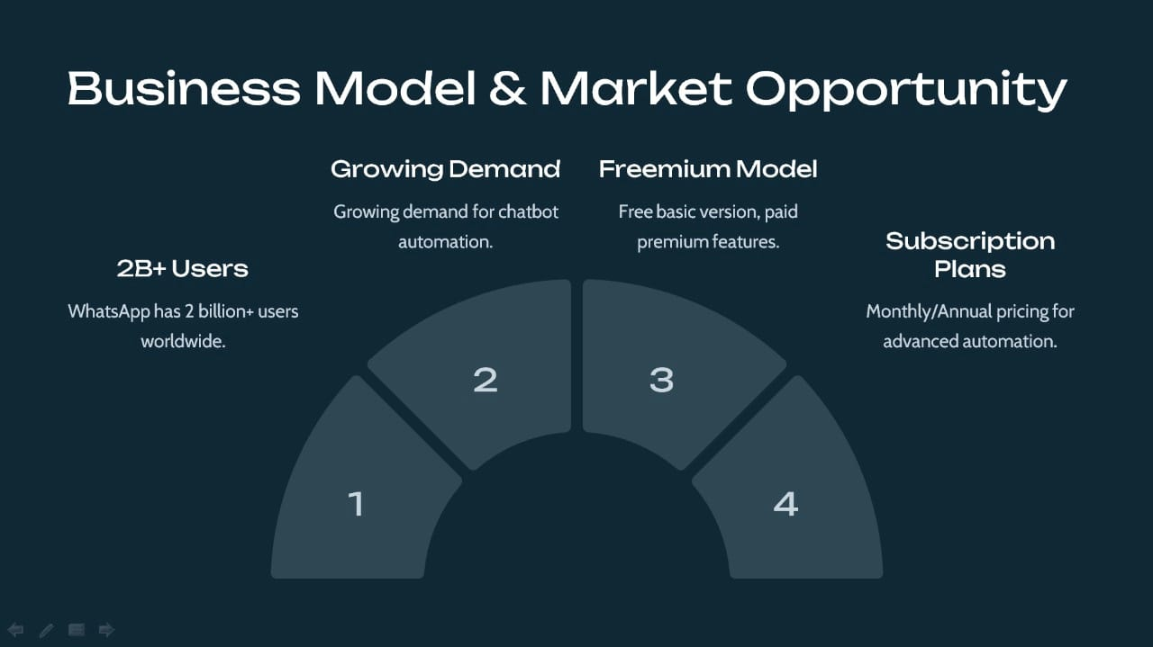




Business Model & Market Opportunity
Growing Demand
Freemium Model
Growing demand for chatbot automation.
Free basic version, paid premium features.
Subscription Plans
2B+ Users
WhatsApp has 2 billion+ users worldwide.
Monthly/Annual pricing for advanced automation.
2
3
1
4

Slide 9
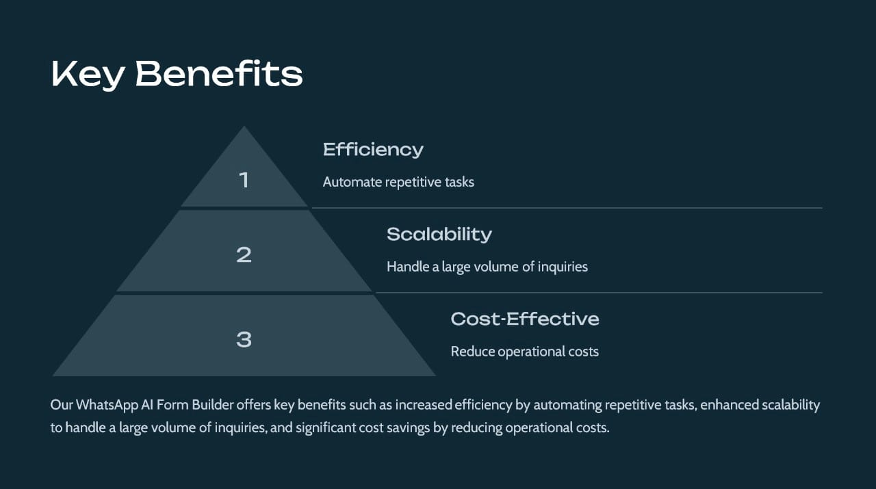



Key Benefits
Efficiency
1
Automate repetitive tasks
Scalability
2
Handle a large volume of inquiries
Cost-Effective
3
Reduce operational costs
Our WhatsApp AI Form Builder offers key benefits such as increased efficiency by automating repetitive tasks, enhanced scalability to handle a large volume of inquiries, and significant cost savings by reducing operational costs.

Slide 10

Next Steps
1
2
Sign Up
Explore Features
Create an account on our platform.
Familiarize yourself with the drag-and-drop builder.
3
Deploy Chatbot
Start automating your WhatsApp conversations.
Ready to transform your WhatsApp interactions? Sign up today, explore our features, and deploy your first chatbot to start automating conversations.

Slide 11

Thank You

